Slide 1
BubbleFormer: Bubble Diagram Generation via Dual Transformer Models
Jiahui Sun, Liping Zheng, Gaofeng Zhang, Wenming Wu
Hefei University of Technology, China
Notes:
Hello everyone. Thank you so much for coming to my talk.
I am presenting our work titled “BubbleFormer: Bubble Diagram Generation via Dual Transformer Models”.

Slide 2
Motivation
Notes:
OK.
First, let‘s get some motivation for this work.

Slide 3
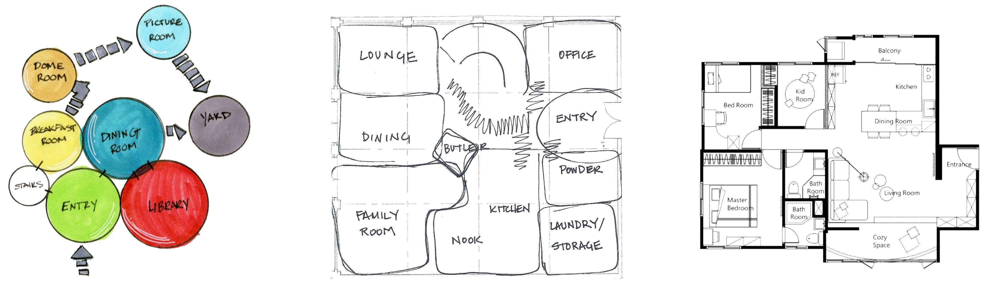
Interior Design
Notes:
Bubble diagrams are able to show the initial division of space, widely used in architectural planning and graphic design.
In the past, bubble diagrams are obtained through hand-drawn sketches or computer-aided design software.
There is a lack of research focused on bubble diagram generation.

Slide 4
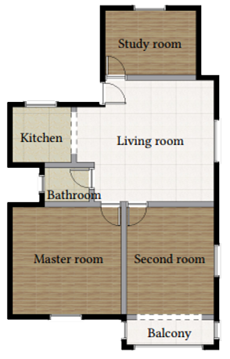
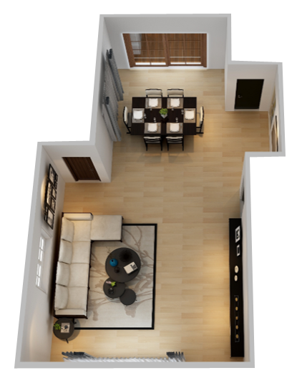

Layout generation
Notes:
Our goal is to automate the generation of bubble diagrams.
Then we can support the downstream tasks of layout design, such as floor plans, furniture arrangements, or magazine plans.

Slide 5
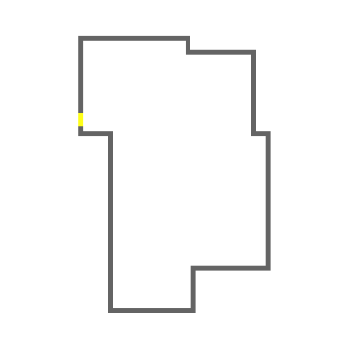
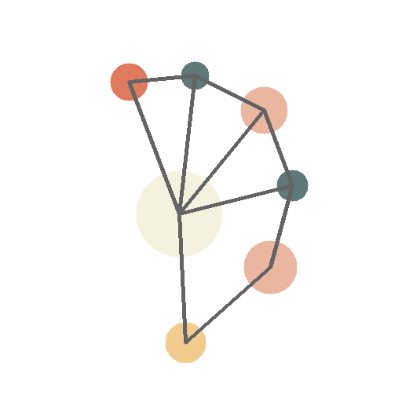
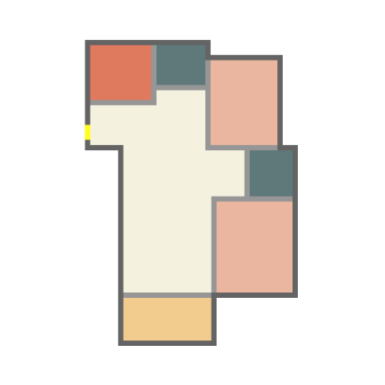

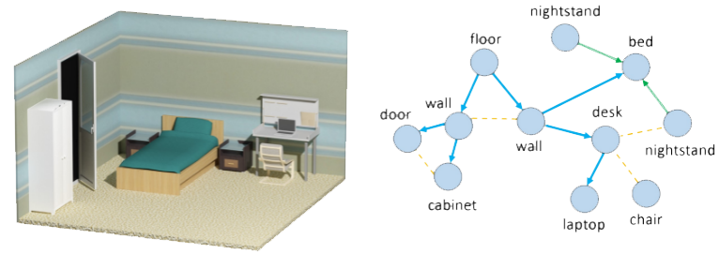

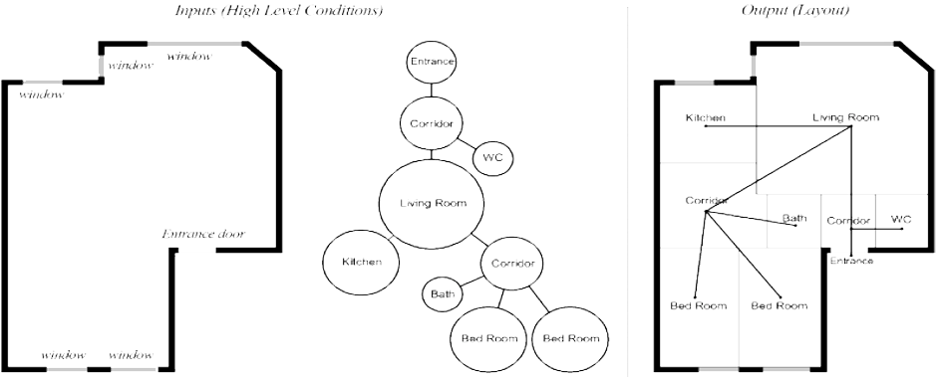
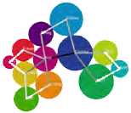
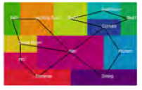
Bubble diagram as input
[Sun et al.2022]
[Zhou et al.2019]
[Rahbar et al.2022]
[Nourian et al.2013]
Notes:
In recent years, many methods have used bubble diagrams as input to study various layout generation problems.

Slide 6
Bubble diagram input from users
WallPlan [Sun et al.2022]
Notes:
However, in most of the current methods, the input bubble diagrams are provided by users, such as. WallPlan.

Slide 7
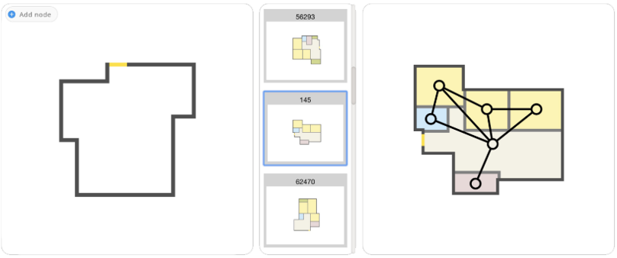
Bubble diagram input from retrieval
Graph2Plan [Hu et al. 2020]
Notes:
Other methods use an indirect way to obtain bubble diagrams, such as Graph2Plan, retrieving bubble diagrams from a dataset to obtain the input bubble diagrams.

Slide 8
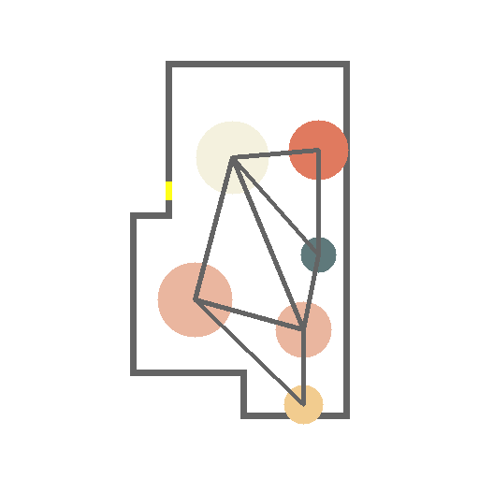
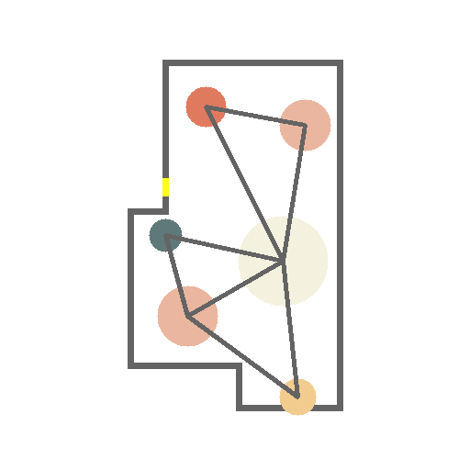
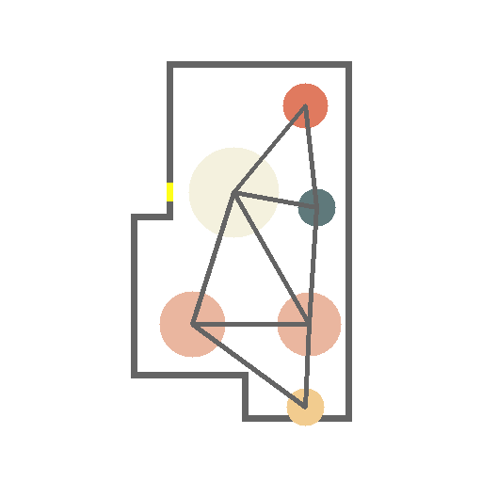
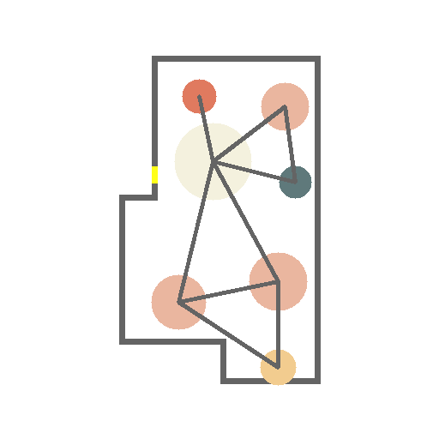
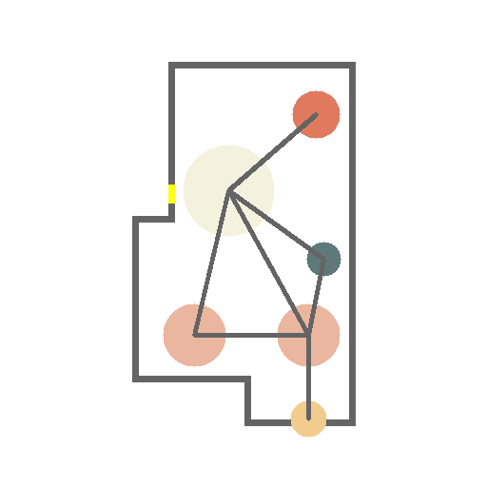
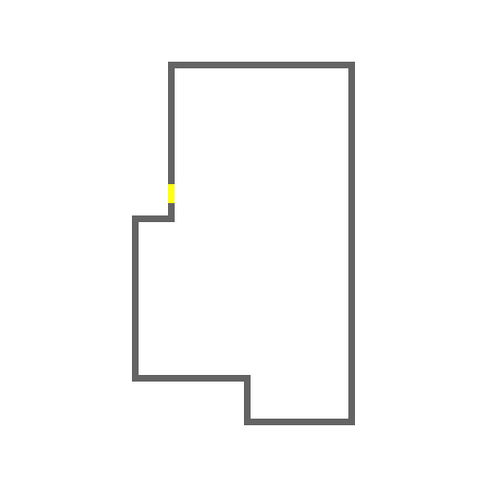
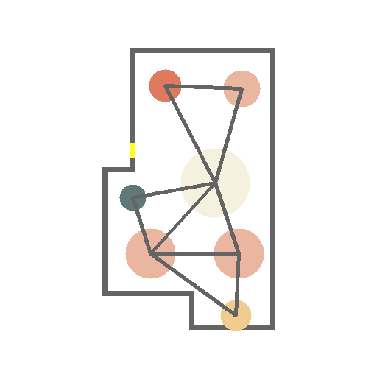
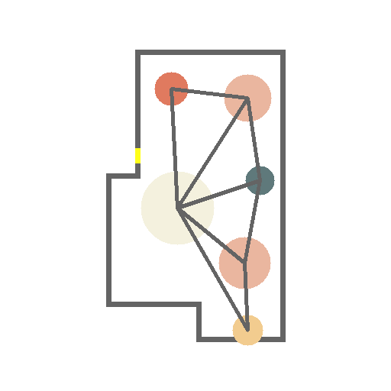
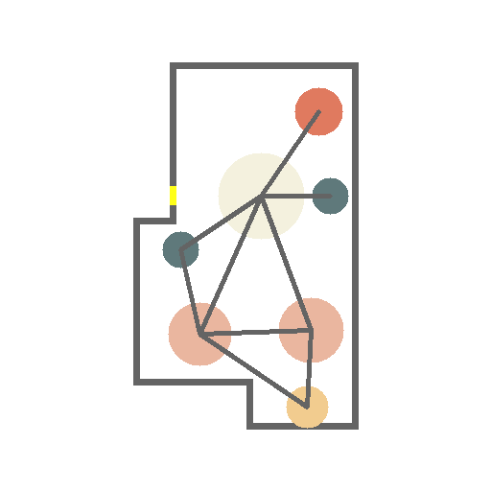
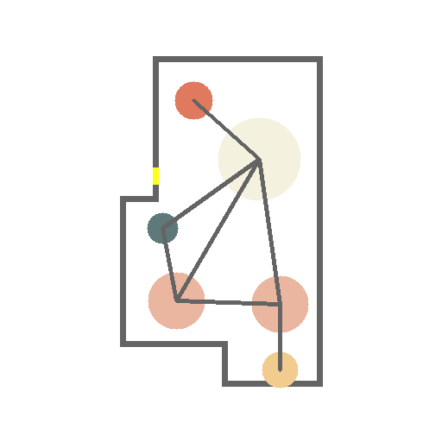
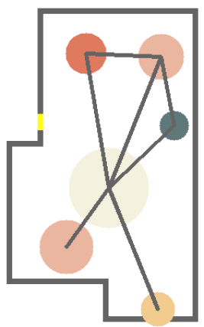
Goal
BubbleFormer
Living room
Bedroom
Kitchen
Bathroom
Balcony
Storage
Notes:
We find that an important part of layout generation is missing, that is, the generation of bubble diagrams.
In this work, our goal is to generate diverse bubble diagrams from the given boundary.

Slide 9
Method
Notes:
OK.
We now introduce our method.

Slide 10
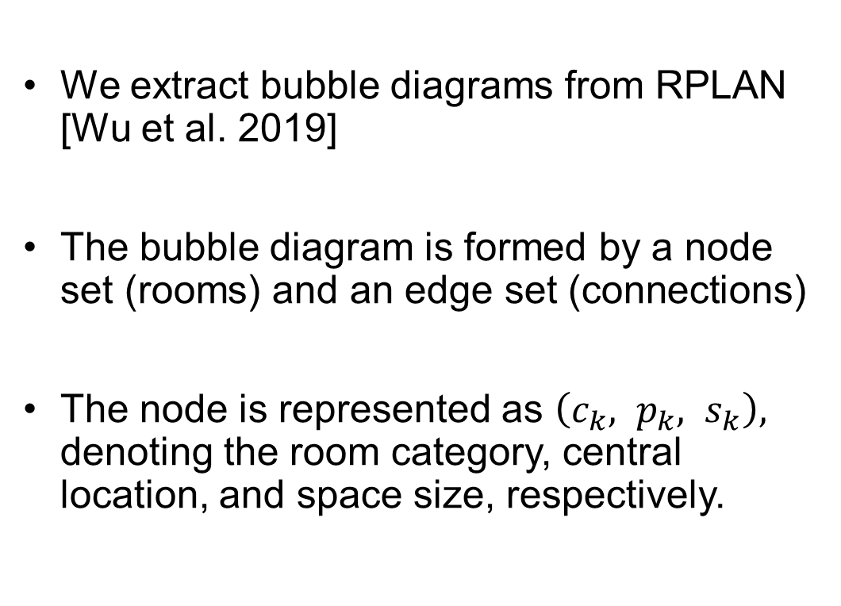
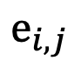
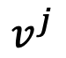
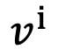
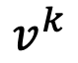
Bubble diagram representation
We extract bubble diagrams from RPLAN [Wu et al. 2019]
The bubble diagram is formed by a node set (rooms) and an edge set (connections)
The node is represented as $\left(c_{k}, p_{k}, s_{k}\right),$ denoting the room category, central location, and space size, respectively.
$$v^{k}$$
$$v^{j}$$
$$e_{i,j}$$
$$v^{i}$$
Notes:
We first introduce the bubble diagram representation.
To build dataset, we extract bubble diagrams from RPLAN, a existing large-scale floorplan dataset.
The bubble diagram can be represented by the graph, which is formed by a node set, the rooms, and an edge set, the connections.
The node is represented by a vector, denoting the room category, central location, and space size, respectively.

Slide 11
Bubble diagram generation
Room node generation
Room topology generation
The node and edge are generated together end-to-end
Node
Edge
Notes:
So, for the bubble diagram generation.
First, bubble diagram generation needs to consider the room node generation.
Second, a reasonable room topology needs to be determined among the nodes.
Finally, we want the two to be generated jointly in an end-to-end manner.

Slide 12
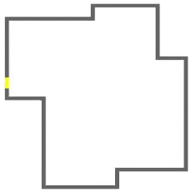
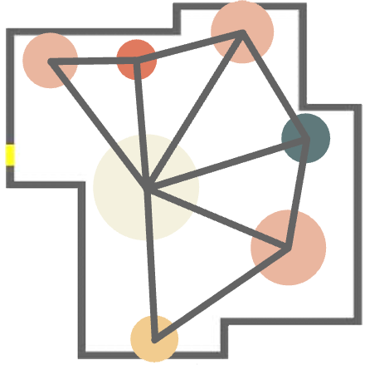
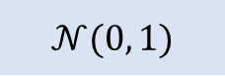
BubbleFormer
Encoder
Decoder
Encoder
Decoder
$$𝒩(0, 1)$$
Sampling
Pointer Match
NodeFormer
EdgeFormer
Notes:
We show the network architecture of BubbleFormer.
In the dual-transformer network of Bubbleformer,
the NodeFormer and EdgeFormer are used to generate nodes and edges, respectively.
In addition, we embed the VAE module in NodeFormer for generating diverse bubble diagrams.

Slide 13
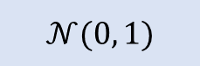
NodeFormer
BNet
Positional encoding
Encoder
Decoder
Training
ENet
Testing
NodeFormer
$$𝒩(0, 1)$$
Notes:
For node generation, we use a non-autoregressive Transformer network to generate all room nodes simultaneously.
In the inference phase, the noise map sampled from the normal distribution and the input boundary are jointly used as input to NodeFormer.

Slide 14
EdgeFormer
BNet
Encoder
Decoder
Positional encoding
NodeFormer
Node matching
EdgeFormer
Notes:
For edge generation, we also use a non-autoregressive Transformer network to generate all edge pointers simultaneously.
In the inference phase, the node embedding from NodeFormer and the input boundary are jointly used as input to EdgeFormer.
The final set of edges can be obtained by the Hungary matching between the edge pointers and nodes.

Slide 15
Experiment
Notes:
OK.
We now show our experimental results.

Slide 16

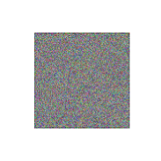

Ablation
NodeFormer
Ablation 2:
Parallel Transformer
Pointer Match
EdgeFormer
Ablation 1:
Dual VAEs
Notes:
We first design two ablation experiments to verify the model design of our BubbleFormer.
For the first ablation experiment, we set VAE for both NodeFormer and EdgeFormer, constructing a dual VAE structure.
For the second one, we remove the embedding of Nodeformer from Edgeformer, forming a parallel dual-transformer structure.

Slide 17
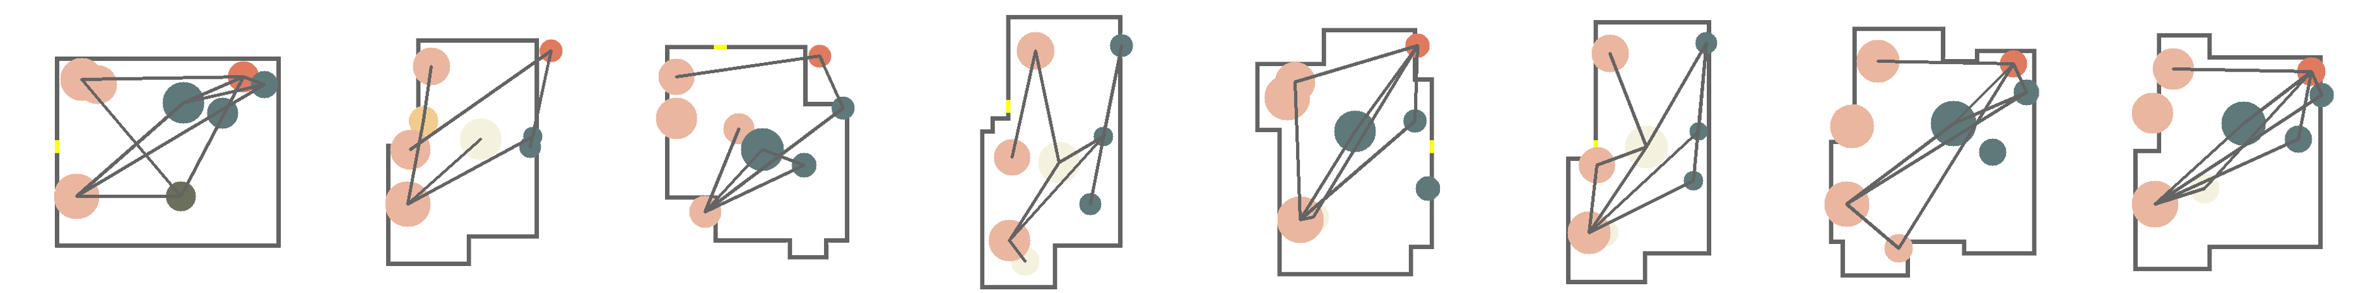
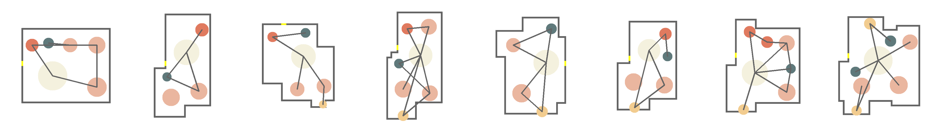
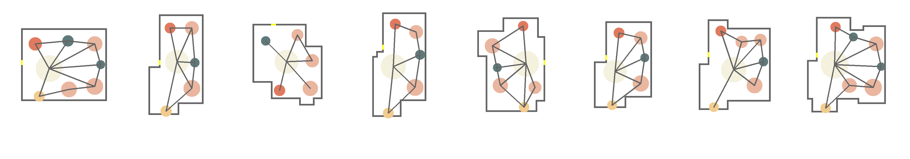
Ablation
Living room
Bedroom
Kitchen
Bathroom
Balcony
Storage
Ablation 1: Dual VAE
Ablation 2: Parallel Transformer
Ours: BubbleFormer
Notes:
Here we show the results of two ablation experiments compared to our method.
It can be clearly seen that the bubble diagrams generated by the two ablation experiments are not as good as those of our full method.

Slide 18
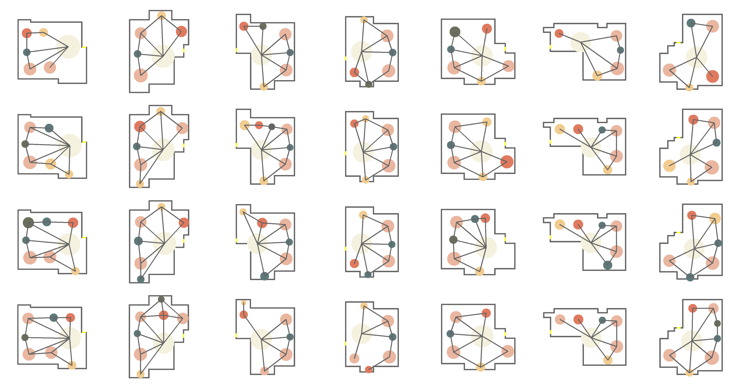
Constrained generation
(2, 1, 1)
(3, 1, 1)
(2, 2, 1)
(3, 1, 1)
(bedroom, bathroom, balcony)
Notes:
We show a set of bubble diagrams generated by boundary constraints. The generated results can be sampled by room category constraints.
For example, the floorplan of the first row generates 2 bedrooms, 1 bathroom. and 1 balcony.

Slide 19
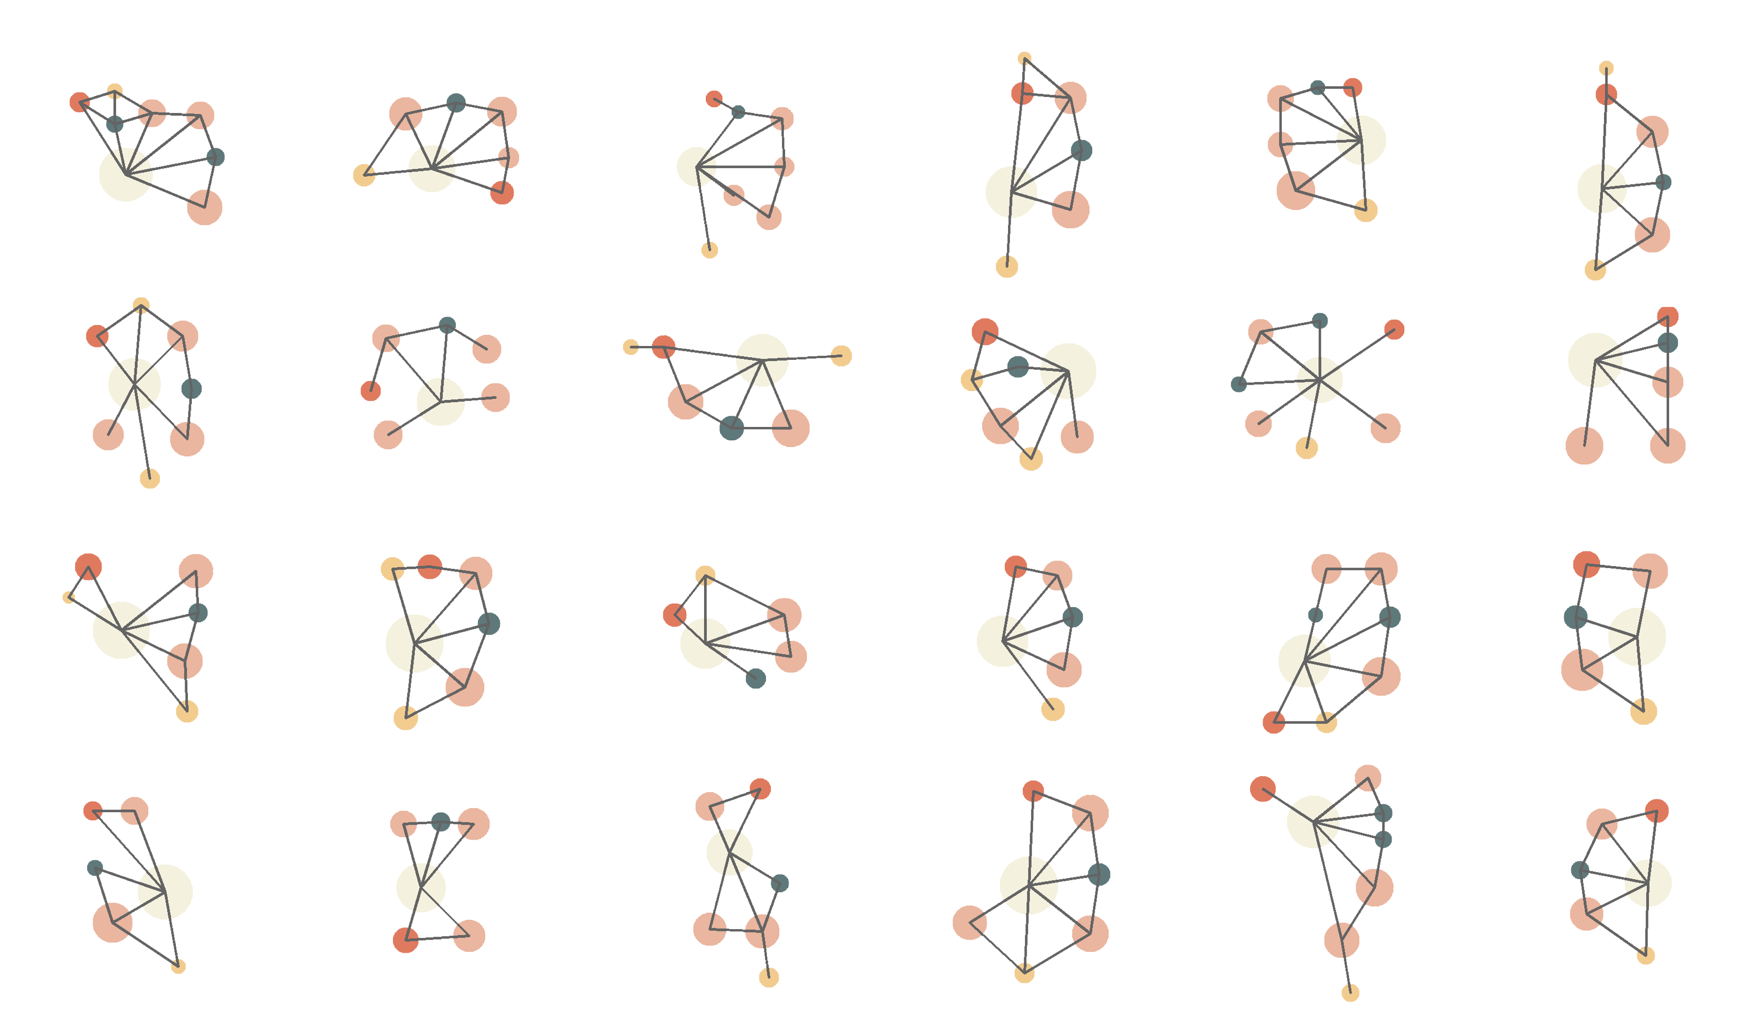
Unconstrained generation
Living room
Bedroom
Kitchen
Bathroom
Balcony
Storage
Notes:
BubbleFormer also supports unconstrained generation.
The resulting bubble diagrams are generated from the sampled noise map only.

Slide 20
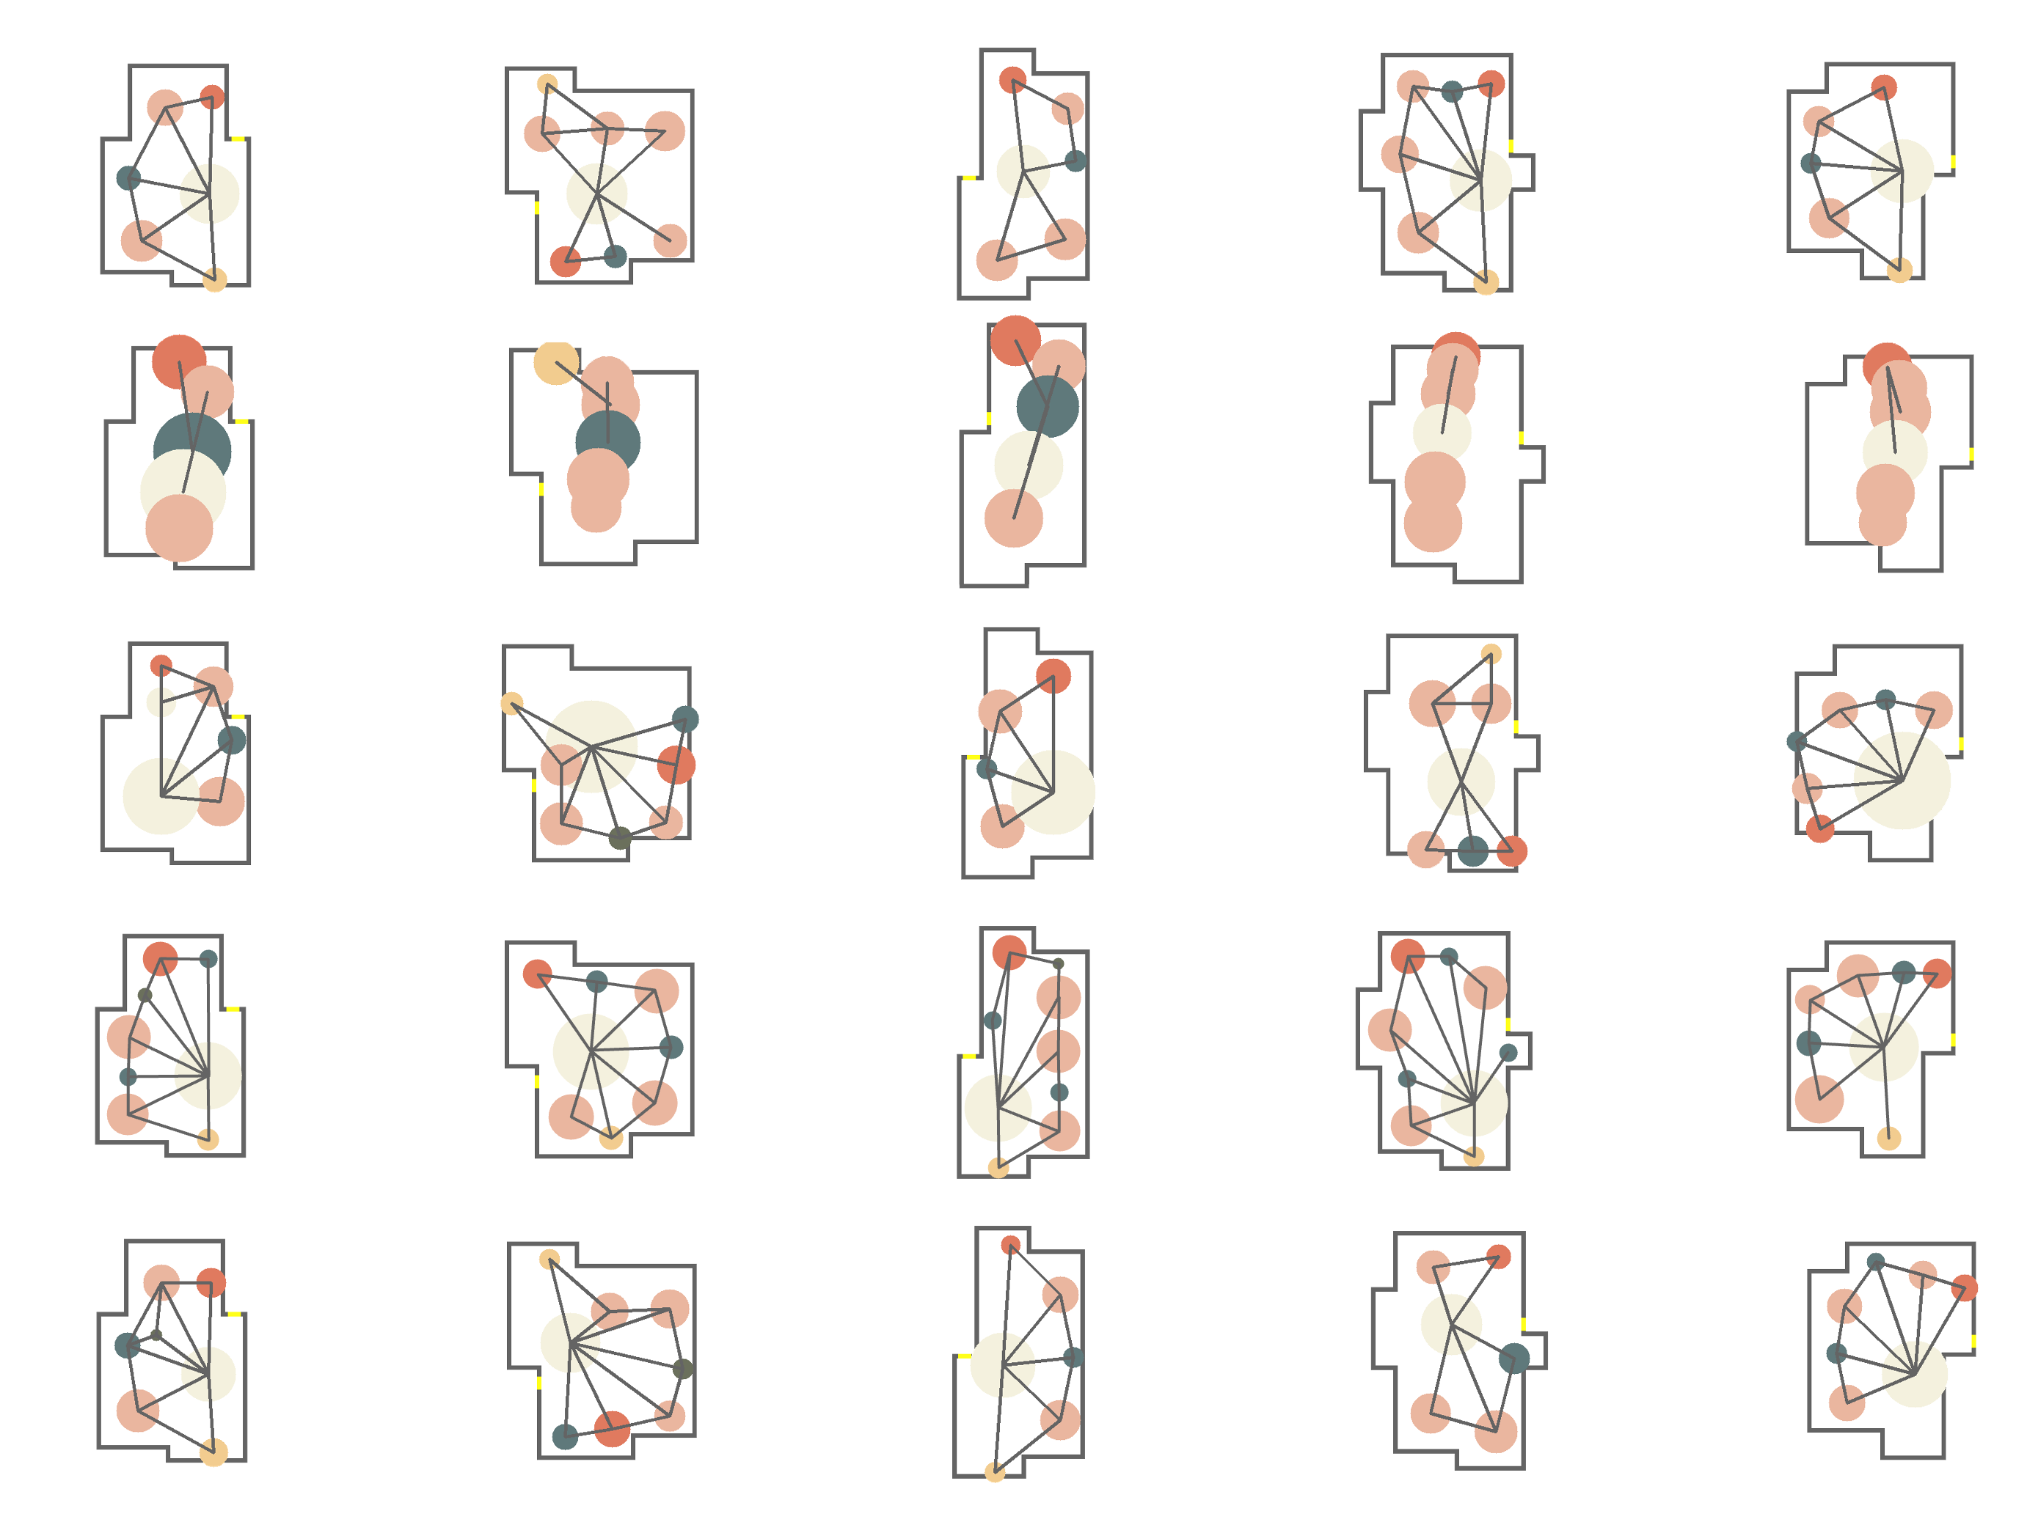
Dataset boundary constrained generation
Ours
DGMG
[Li et al. 2019]
Graph2Plan
[Hu et al. 2020]
Expert
GT
Notes:
Given the input boundaries from the dataset, the generated bubble diagrams are displayed, including our method, DGMG, Graph2Plan, expert design, and the Ground Truth.
From the results, we can observe that the Ground Truth, expert design, and our method follow similar design principles, where rooms are evenly distributed within the boundaries, and most rooms are connected to the living room.
However, the results generated by DGMG exhibit terrible layouts, and the results of Graph2Plan cannot fully conform to boundaries.

Slide 21
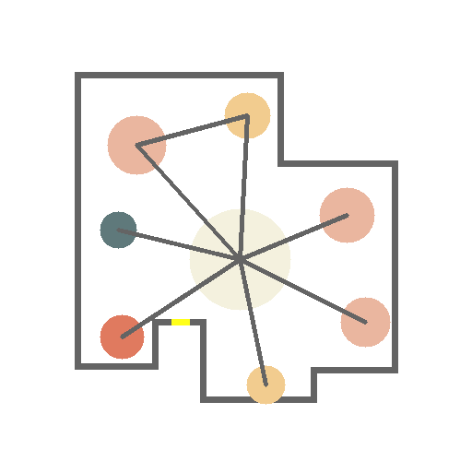
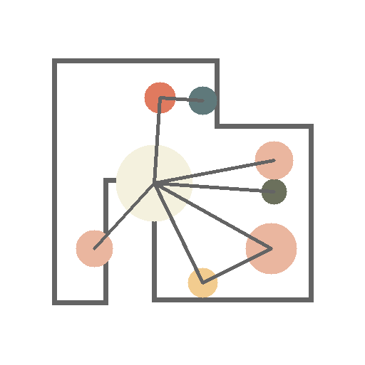
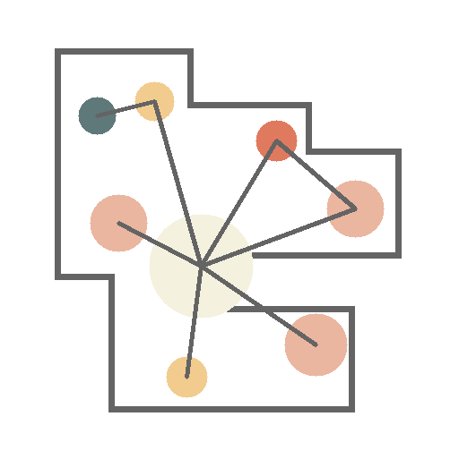
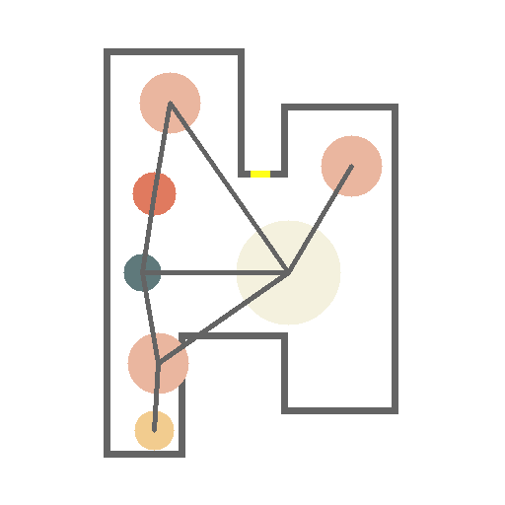
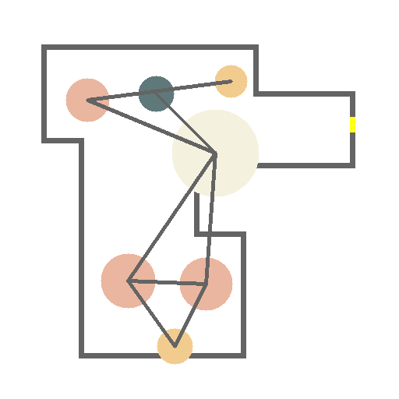
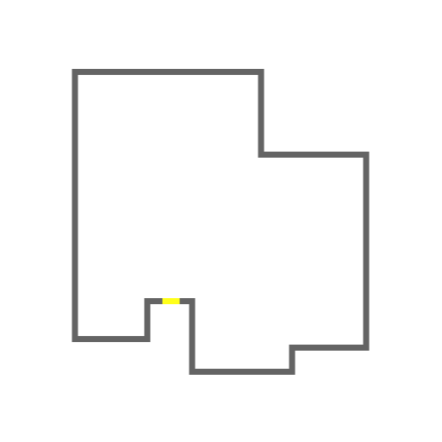
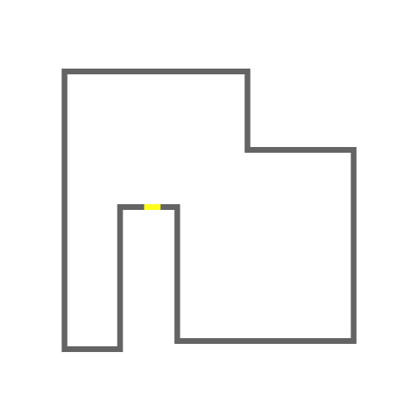
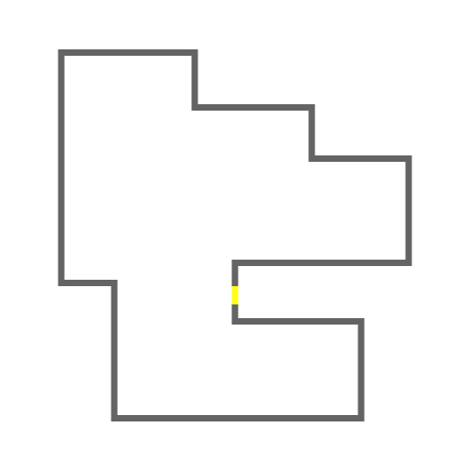

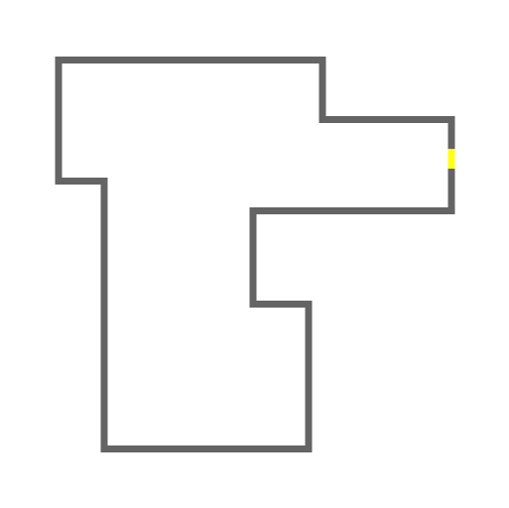
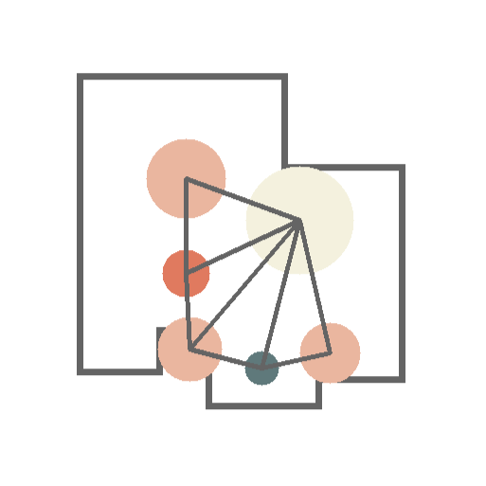
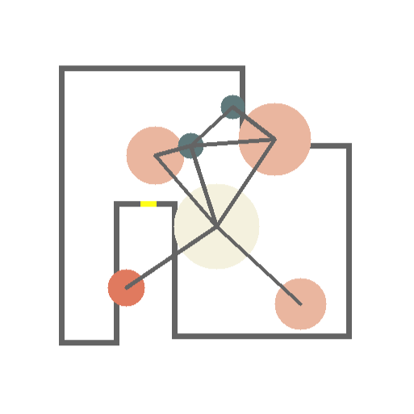
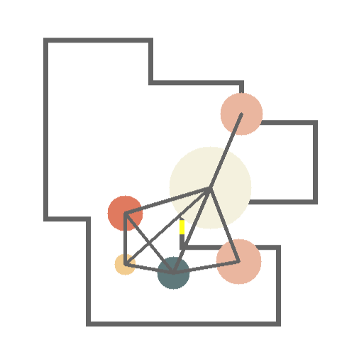







Hand-drawn boundary constrained generation
Ours
Expert
Graph2Plan
[Hu et al. 2020]
DGMG
[Li et al. 2019]
Notes:
To demonstrate the effectiveness of BubbleFormer, we introduce hand-drawn boundaries as input.
Compared to the realistic boundaries, these hand-drawn boundaries are simpler, rougher, lack of design considerations, and exhibit higher variability.
Similarly, our results and expert-designed layouts both outperform other methods significantly.

Slide 22

Quantitative evaluation
FID comparison for generated bubble diagrams
Method | DGMG | BubbleFormer | Graph2Plan
FID | 177.00 | 16.97 | 82.64
FID comparison for the generated floor plan
Method | DGMG | BubbleFormer | GT
FID | 80.18 | 4.17 | 0.63
Statistics comparsion. The ratio close to 1 shows means higher quality
Method | $$R_{\text{avg} }$$ | $$C_{\text{avg} }^{l}$$ | $$C_{\text{avg} }^{r}$$ | $$R_{\text{avg} }^{l}$$ | $$L_{\text{avg} }^{a}$$
$$DGMG$$ | 0.895 | 0.398 | 0.413 | 0.536 | 0.401
BubbleFormer | $$0.945$$ | $$0.851$$ | 0.906 | $$1.001$$ | $$1.026$$
Notes:
We also conduct quantitative experiments to provide a more objective evaluation of the generation quality of BubbleFormer.

Slide 23

Perceptual study
Based on your design experience, rate the bubble diagram under this boundary, with 1 being the lowest and 5 being the highest.
Notes:
To better evaluate from a professional view, we have also conducted a perceptual study to evaluate the plausibility of the generated bubble diagrams.
For each task, the participants are asked to evaluate the results on a five-point rating from 1 to 5.
with 1 being the terrible and 5 being the excellent.

Slide 24
Perceptual study
The result of perceptual study
Terrible
8.9%
15.3%
Poor
20%
Average
27.6%
Good
Excellent
27.7%
Notes:
We collect a total of 1,000 results from 20 designers with professional design backgrounds.
According to the feedback from designers, 70.6% of our results received a score of 3 or higher.
This indicates that the most of our results have achieved a high level of quality.
We can offer designers various inspiring alternative solutions.

Slide 25


Application: floorplan generation
Generated floor plans by HouseGAN++ [Nauata et al. 2021]
Living room
Bedroom
Kitchen
Bathroom
Balcony
Storage
Notes:
BubbleFormer can support downstream layout generation, such as floorplan generation.
We can use our generated bubble diagrams to drive HouseGAN++ to generate various floorplans.

Slide 26




















Application: floor plan generation
Generated Floorplans by WallPlan [Sun et at. 2022] using our bubble diagrams
Living room
Bedroom
Kitchen
Bathroom
Balcony
Storage
Notes:
Here are generated floorplans by WallPlan using our bubble diagrams.

Slide 27


More applications
Table
TV stand
Wardrobe
Nightstand
Bed
Text
Image
Headline
Text-over-image
Head-over-image
Notes:
We also explore the potential of BubbleFormer in generating other graphic designs, such as the furniture arrangement and document layout.
We can observe that in both of these tasks, BubbleFormer can generate high-quality layouts.

Slide 28
Conclusion

Slide 29
Conclusion
A first learning-based approach for generating bubble diagrams in an end-to-end way, which can support downstream floor plan generation
Dual Transformers to model the nodes and edges in bubble diagrams and Hungarian matching to enables end-to-end training
Notes:
In conclusion, to the best of our knowledge, this is the first learning-based method for generating bubble diagrams.
It completes existing graph-driven generation methods by addressing a crucial missing link - the generation of graph.
Technically, we have designed a dual-transformer structure embedded with VAE that can produce a large number of high-quality bubble diagrams.

Slide 30
Acknowledgements
All participants of perceptual studies
All anonymous reviewers
All funding agencies
Notes:
We would like to thank all participants for evaluating our results,
and all the anonymous reviewers for their constructive suggestions and comments.
And all funding agencies for their contribution to this project.

Slide 31
Thank you
Notes:
Thanks for your attention.

Slide 32


Wenming Wu
Hefei University of Technology
Notes:
I am Wenming Wu from Hefei University of Technology in China.
My research interests are Computer Graphics and Computer Vision.
You can pick up your phone to scan the QR code for more research work of mine if you want.

